Slide 1
Bi-Weekly Progress Report
H&M Personalized Fashion Recommendations
Data Science Applications | Progress Report
2022710508
김동욱
Notes:
“Learning from Imbalanced data”는 2009년 IEEE(미국 전기전자학회)를 통해 발행된 논문입니다.
과학기술이 발전하면서 raw data의 가용성과 성장이 폭발적으로 늘어나고 있는 가운데, 이를 처리하기 위한 관련분야의 기본적인 이해가 중요해지고 있습니다.
이 논문은 이 중 Imbalanced data에 대해 다루고 있으며, 논문에 대한 대략적인 요약내용을 몇 가지 예시와 함께 발표하겠습니다.

Slide 2
Contents
01
Introduction
02
Dataset Description & EDA
03
Rule-based Model
Simple DNN Model
Collaborative Filtering
Experimental Results
04
Summary

Slide 3
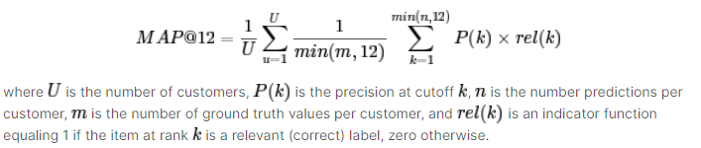
Introduction
H&M Personalized Fashion Recommendations
https://www.kaggle.com/competitions/h-and-m-personalized-fashion-recommendations/overview
Provide product recommendations based on previous purchases
to predict what articles each customer will purchase in the 7-day period immediately after the training data ends. Customer who did not make any purchase during that time are excluded from the scoring.
investigate a categorical data type algorithm, or dive into NLP and image processing deep learning
Final Submission Deadline: 2022.05.09.
Evaluation: Mean Average Precision @ 12 (MAP@12)
Data
Images: images are placed in subfolders starting with the first three digits of the article_id. Not all article_id values have a corresponding image
Transactions_train.csv (31788324, 5): the training data, consisting of the purchases each customer for each date, as well as additional information. Duplicate rows correspond to multiple purchases of the same item.
articles.csv (105542, 25): This table contains all h&m articles with details such as a type of product, a color, a product group and other features.
customers.csv (1371980, 7): Customers data description

Slide 4
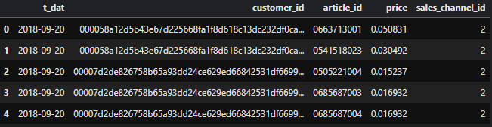
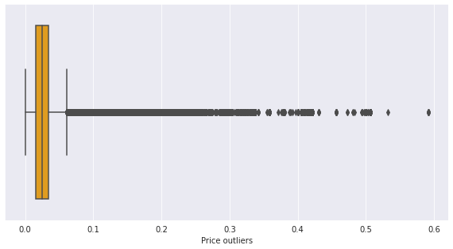
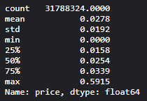
Dataset Description & EDA
[1] Transactions (31788324, 5)
The training data, consisting of the purchases each customer for each date, as well as additional information. Duplicate rows correspond to multiple purchases of the same item
- t_dat : Transaction date
- customer_id : A unique identifier of every customer (in customers table)
- article_id : A unique identifier of every article (in articles table)
- price : Price of purchase
- sales_channel_id : 1 or 2
Price Feature Boxplot & Percentile

Slide 5
Dataset Description & EDA
[2] Articles (105542, 25)
This table contains all h&m articles with details such as a type of product, a color, a product group and other features.
- article_id : A unique identifier of every article.
- product_code, prod_name : A unique identifier of every product and its name (not the same).
- product_type, product_type_name : The group of product_code and its name
- graphical_appearance_no, graphical_appearance_name : The group of graphics and its name
- colour_group_code, colour_group_name : The group of color and its name
- perceived_colour_value_id, perceived_colour_value_name, perceived_colour_master_id, perceived_colour_master_name : The added color info
- department_no, department_name: : A unique identifier of every dep and its name
- index_code, index_name: : A unique identifier of every index and its name
- index_group_no, index_group_name: : A group of indeces and its name
- section_no, section_name: : A unique identifier of every section and its name
- garment_group_no, garment_group_name: : A unique identifier of every garment and its name
- detail_desc: : Details

Slide 6
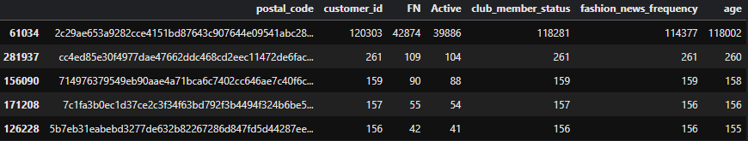
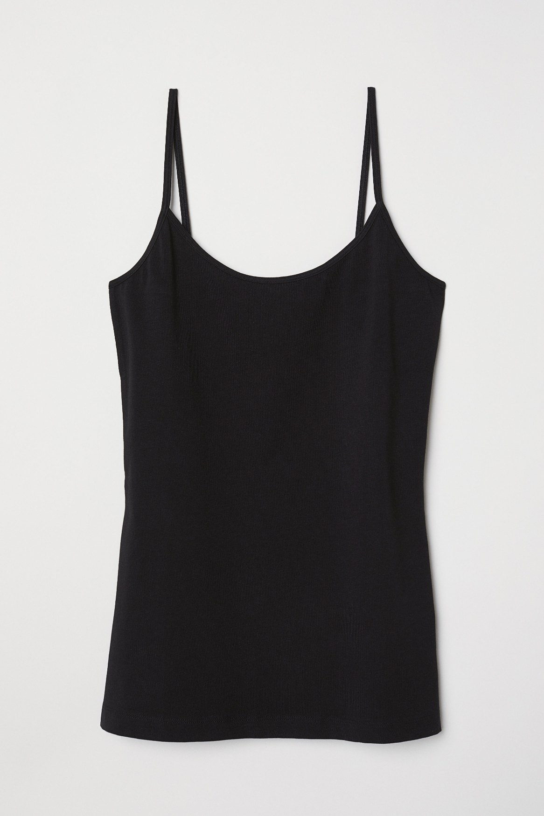
Dataset Description & EDA
[3] Customers (1371980, 7)
Customers data description
- customer_id : A unique identifier of every customer
- FN : 1 or missed
- Active : 1 or missed
- club_member_status : Status in club
- fashion_news_frequency : How often H&M may send news to customer
- age : The current age
- postal_code : Postal code of customer
[4] Images
images are placed in subfolders starting with the first three digits of the article_id.
Not all article_id values have a corresponding image.
0108775015.jpg

Slide 7
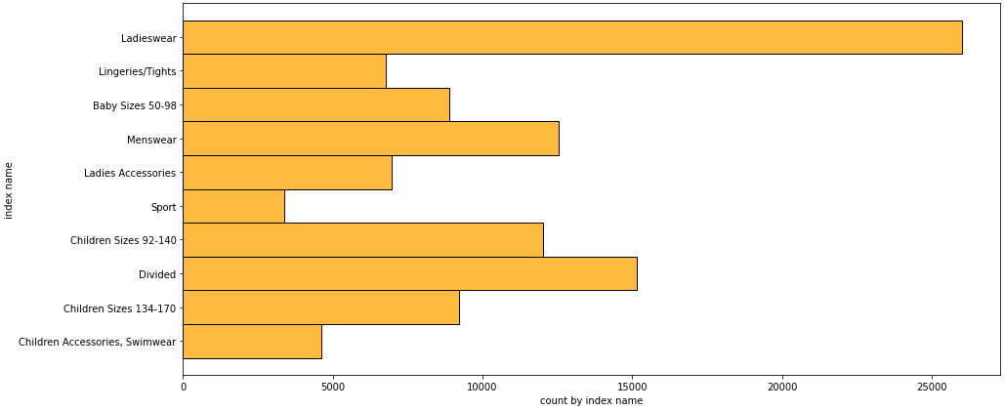
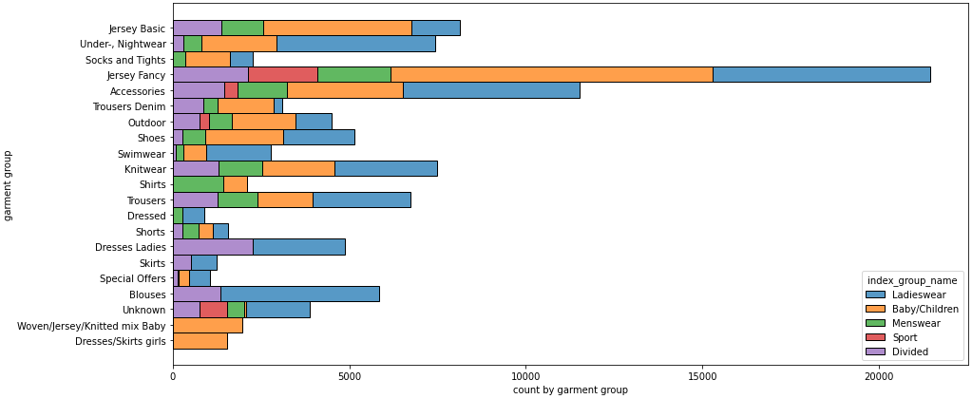
Dataset Description & EDA
EDA
- Ladieswear accounts for a significant part of all dresses.
Sportswear has the least portion.
- The garments grouped by index:
Jersey fancy is the most frequent garment, especially for women and children.
The next by number is accessories, many various accessories with low price.

Slide 8
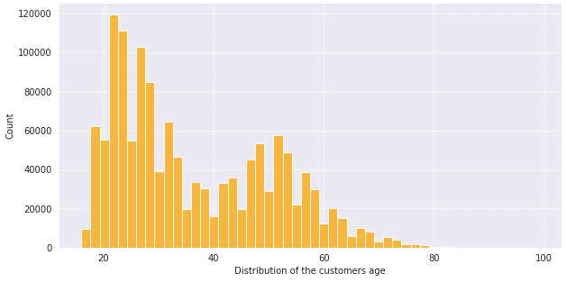
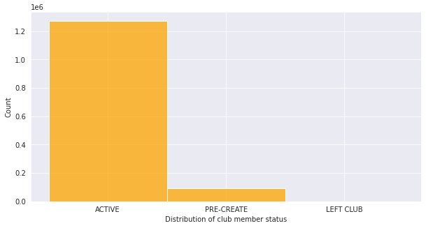
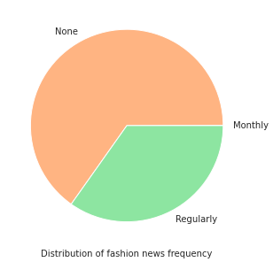
Dataset Description & EDA
EDA
- The most common age is about 21-23
- Status in H&M club. Almost every customer has an active club status,
some of them begin to activate it (pre-create).
A tiny part of customers abandoned the club.
- Customers prefer not to get any messages about the current news.

Slide 9
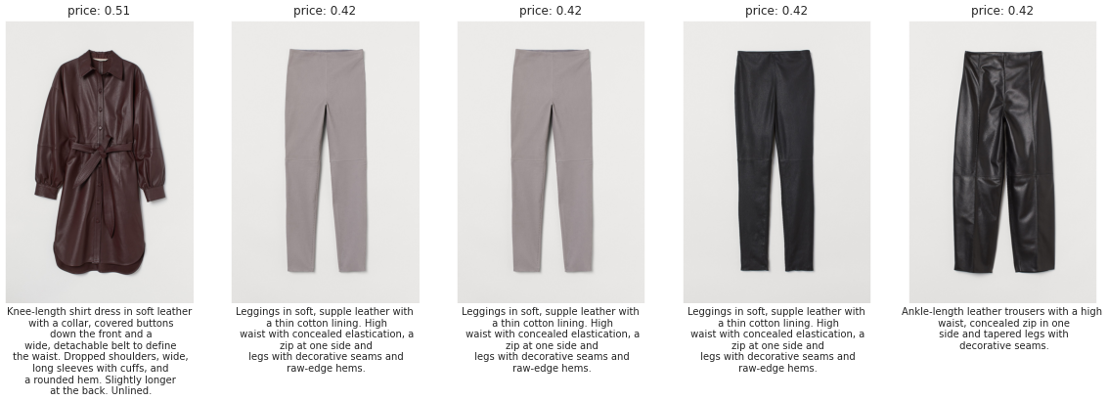
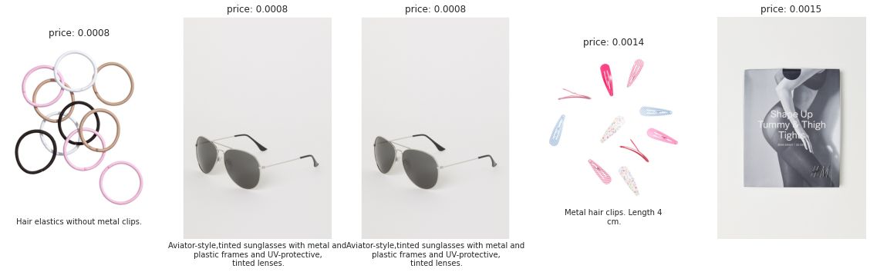
Dataset Description & EDA
EDA
- Photos with description and price (top 5 max)
- Photos with description and price (top 5 min)

Slide 10
Experimental Results
[1] Rule-based model
Recommend Items Purchased Together
: Find Each Customer's Last Week of Purchases
1. Recommend Most Often Previously Purchased Items
- Recommend items that have been purchased more frequently first followed by items purchased more recently second.
2. Recommend Items Purchased Together
- Compute a dictionary of items frequently purchased together.
- Don't recommend an item that the user has already bought and we have already recommended above.
- Recommend previous purchases first and then items purchased together (top 3 items) second.
3. Recommend Last Week's Most Popular Items
- If our previous recommendations did not fill up a customer's 12 recommendations, then it will be filled by popular items.
→ Merge predictions: Public Score 0.0214 (Mean Average Precision @ 12 (MAP@12))

Slide 11
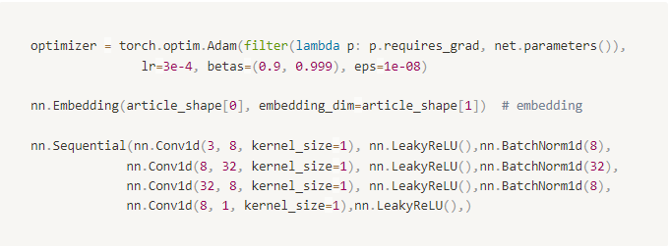
Experimental Results
[2] Simple DNN Model
Conv1d Model
train the model using the latest four weeks of data (train_weeks: [0, 1, 2, 3])
Batch Size: 256, Epochs: 5
Problem: 최근 4주간 거래 이력이 없는 고객은 예측이 어려움
→ 해당 고객은 위 1번 Rule-Based 결과로 대체 (1번 모델 결과값과 결합)
→ Merge predictions: Public Score 0.0205 (Mean Average Precision @ 12 (MAP@12))
→ 오히려 단순 Rule-based 모델보다 성능이 안좋아짐
Add Price Feature
- article의 price를 함께 고려
- Public Score 0.0201 → 오히려 더 성능이 안좋아짐

Slide 12
Experimental Results
[3] Collaborative Filtering
UUCF (user-user collaborative filtering)
For a given user (u), we will search for similar users. Let's say, the 10 most similar users to u. This is u's neighborhood.
We search for the most popular items in this neighborhood of users similar to u, I
We check the items that are popular in the group of users similar to u, that u hasn't purchased yet.
We recommend those items to u
MINIMUM_PURCHASES = 5 (Users who have purchased more than 5 times)
DATE: '2020-08-21’ ~ ‘2021-09-20’ (Recent 1 month)
Cold-start Problem: Use Rule-Based Model Result
코드 테스트 진행 중
추가 MF 기법 적용 예정
앙상블 기법 추가
성능 비교
성능 낮은 모델 원인 분석
LSTM 모델 추가
…

